Slide 1
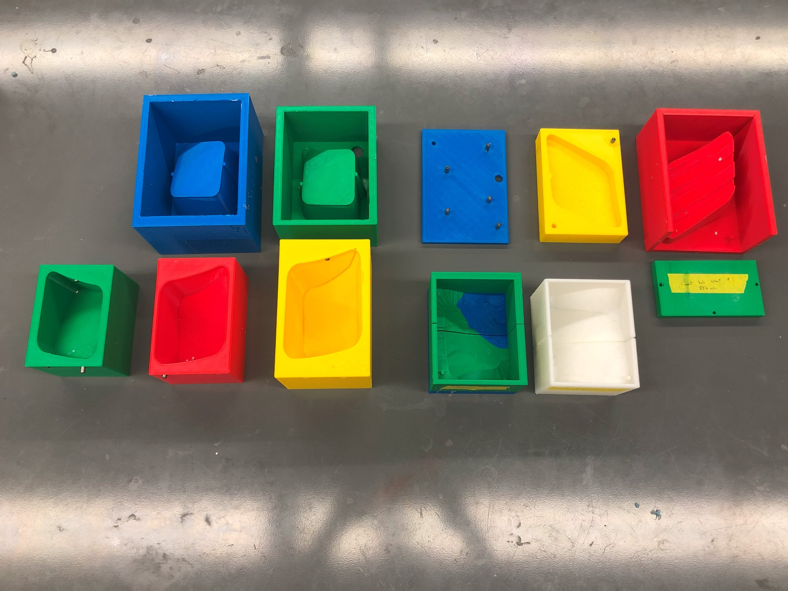
pec_minor_mold_1
pec_major_mold_1
chest_tube_intermediate_mold_1a
chest_tube_intermediate_mold_2
chest_tube_insert_mold_2_attachment_plate
serratus_mold_2
pec_minor_mold_2
pec_major_mold_2
pecs_inserts_fusing jig_intermediate_mold_1 and 2

Slide 2
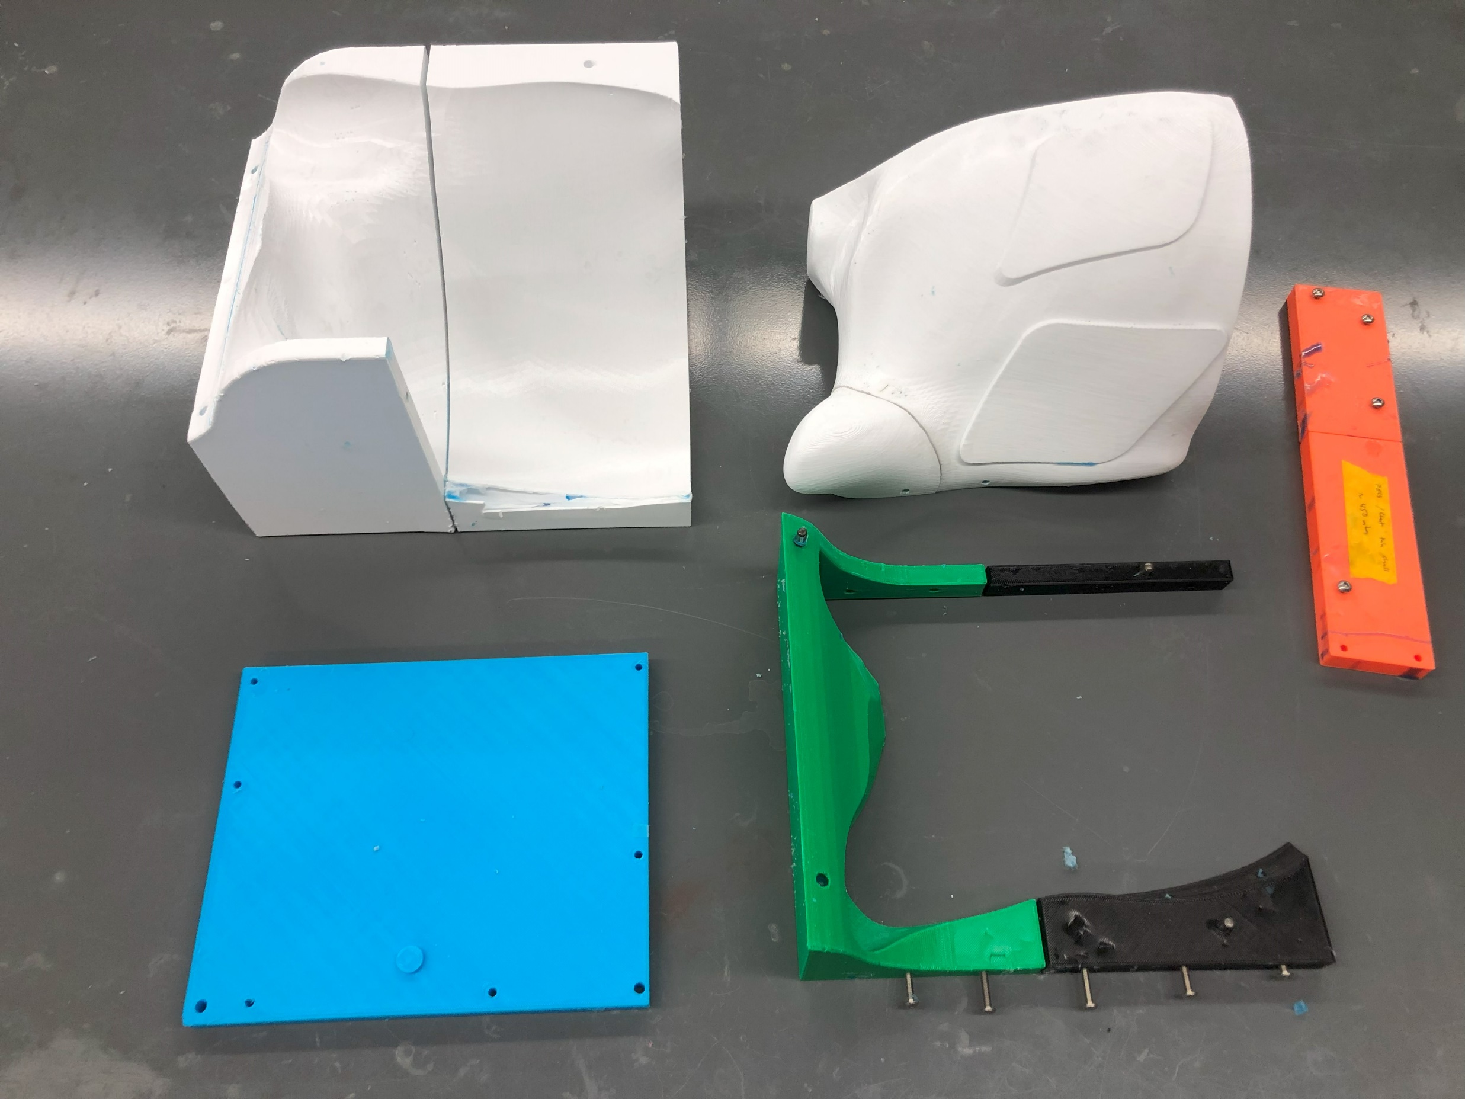
shell_mold_inner
shell_mold_outer_1_2
shell_mold_inner_support_bar
shell_mold_outer_end
shell_mold_outer_3_4_5

Slide 3
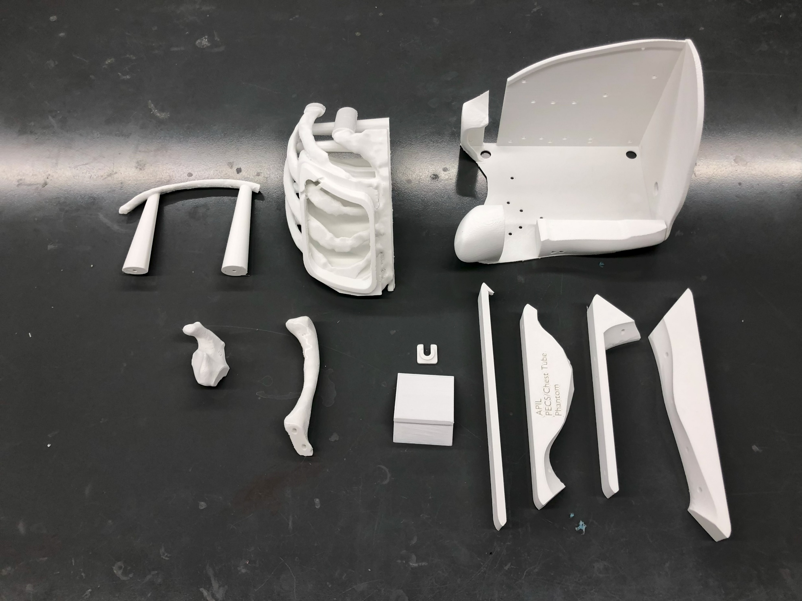
base_plate
ribs_1
ribs_2
retaining_ring
scapula_partial
clavicle
qr_code_holder
shell_outer_clamp

Slide 4
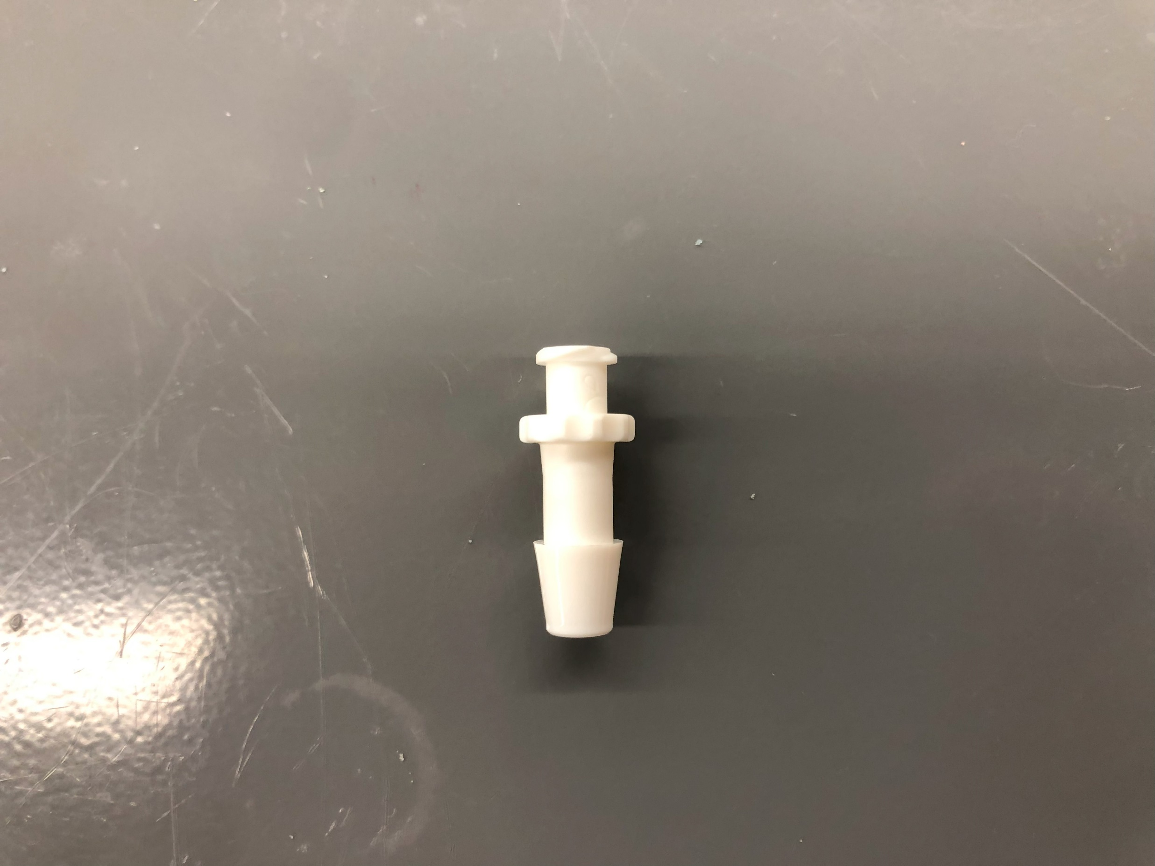
Cut Here

Slide 5
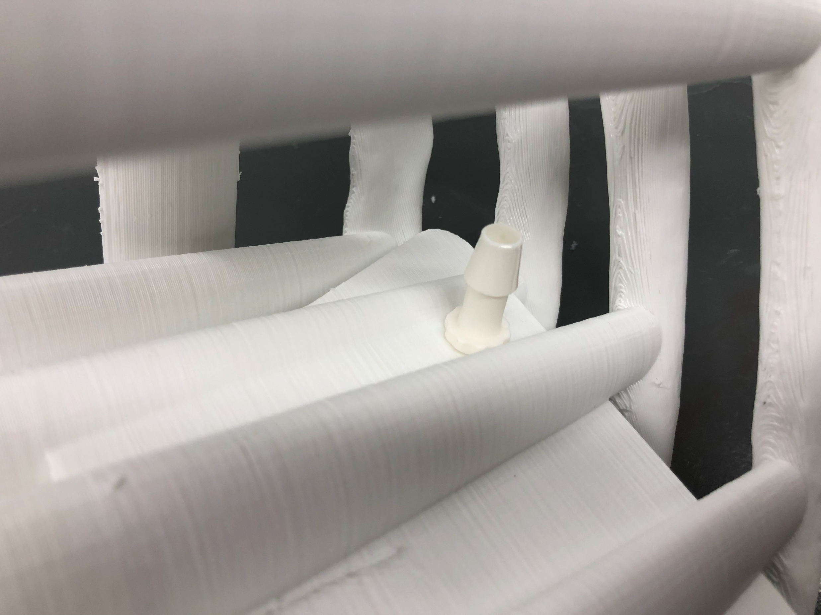

Slide 6
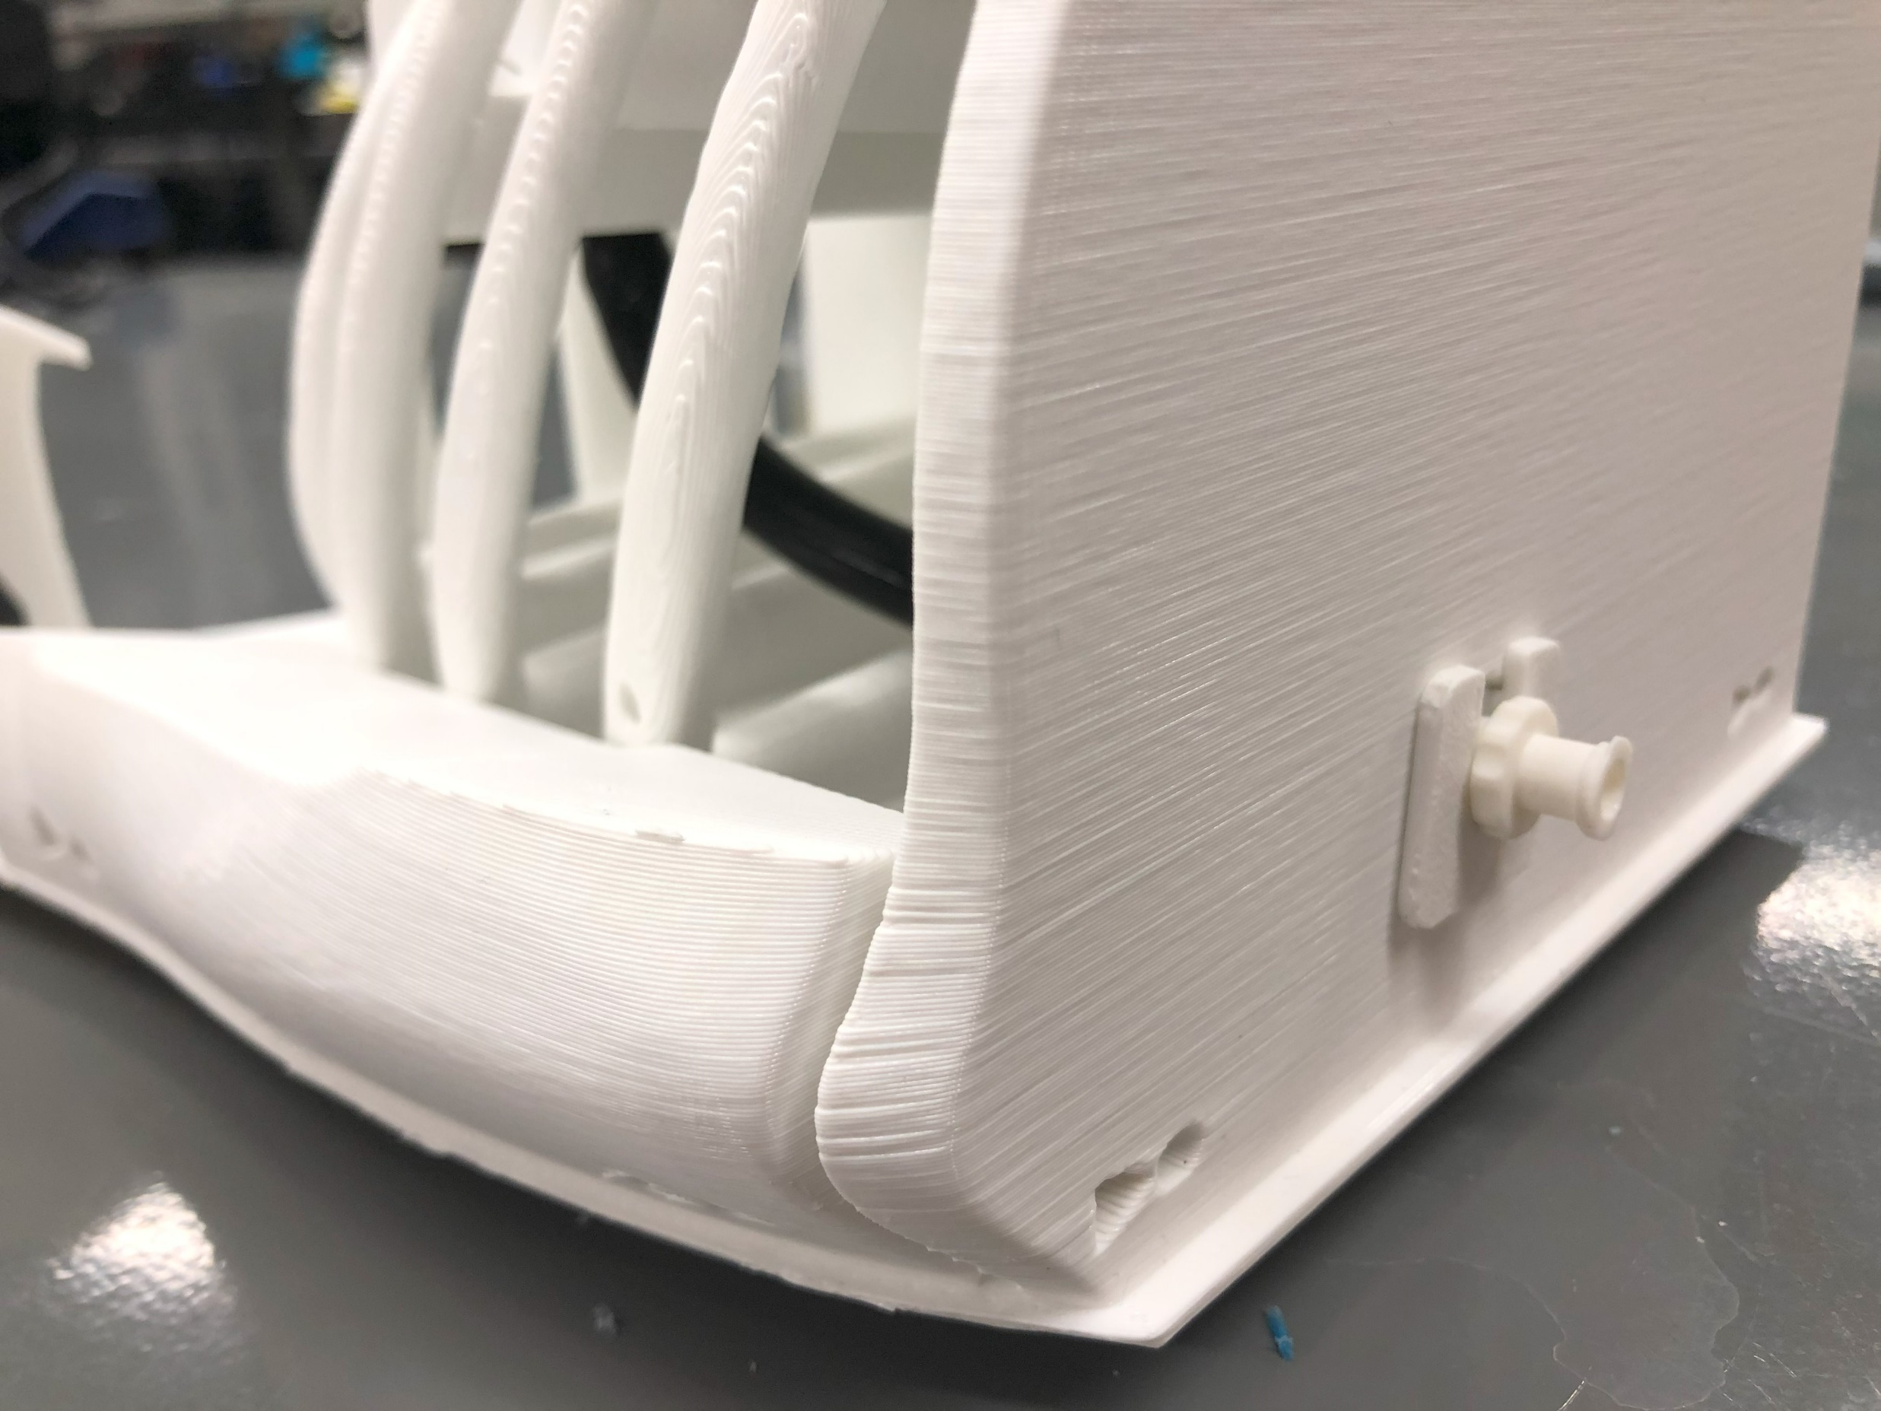

Slide 7
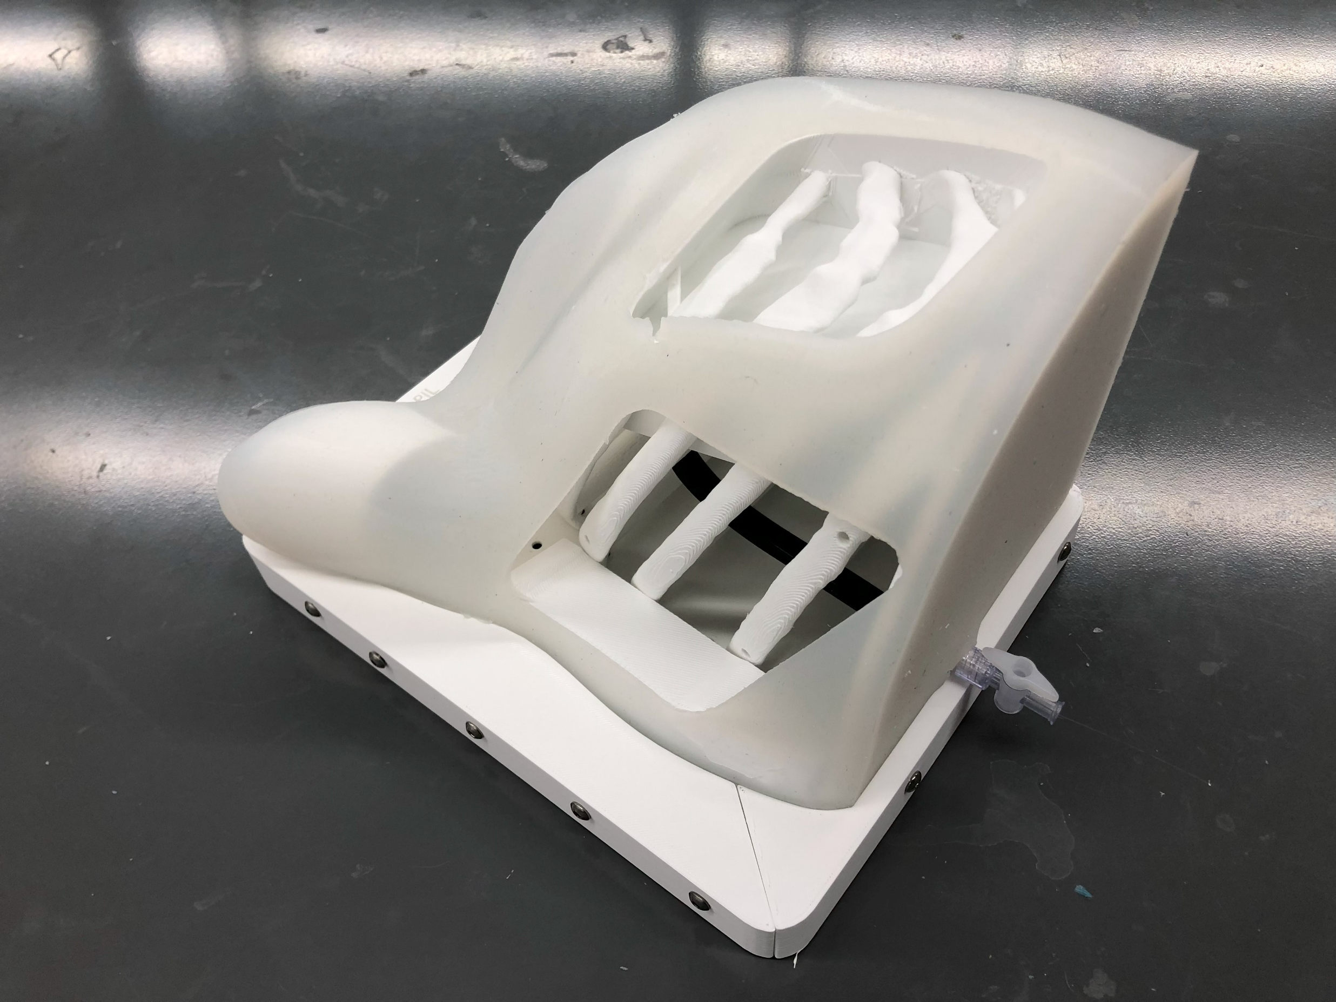

Slide 8
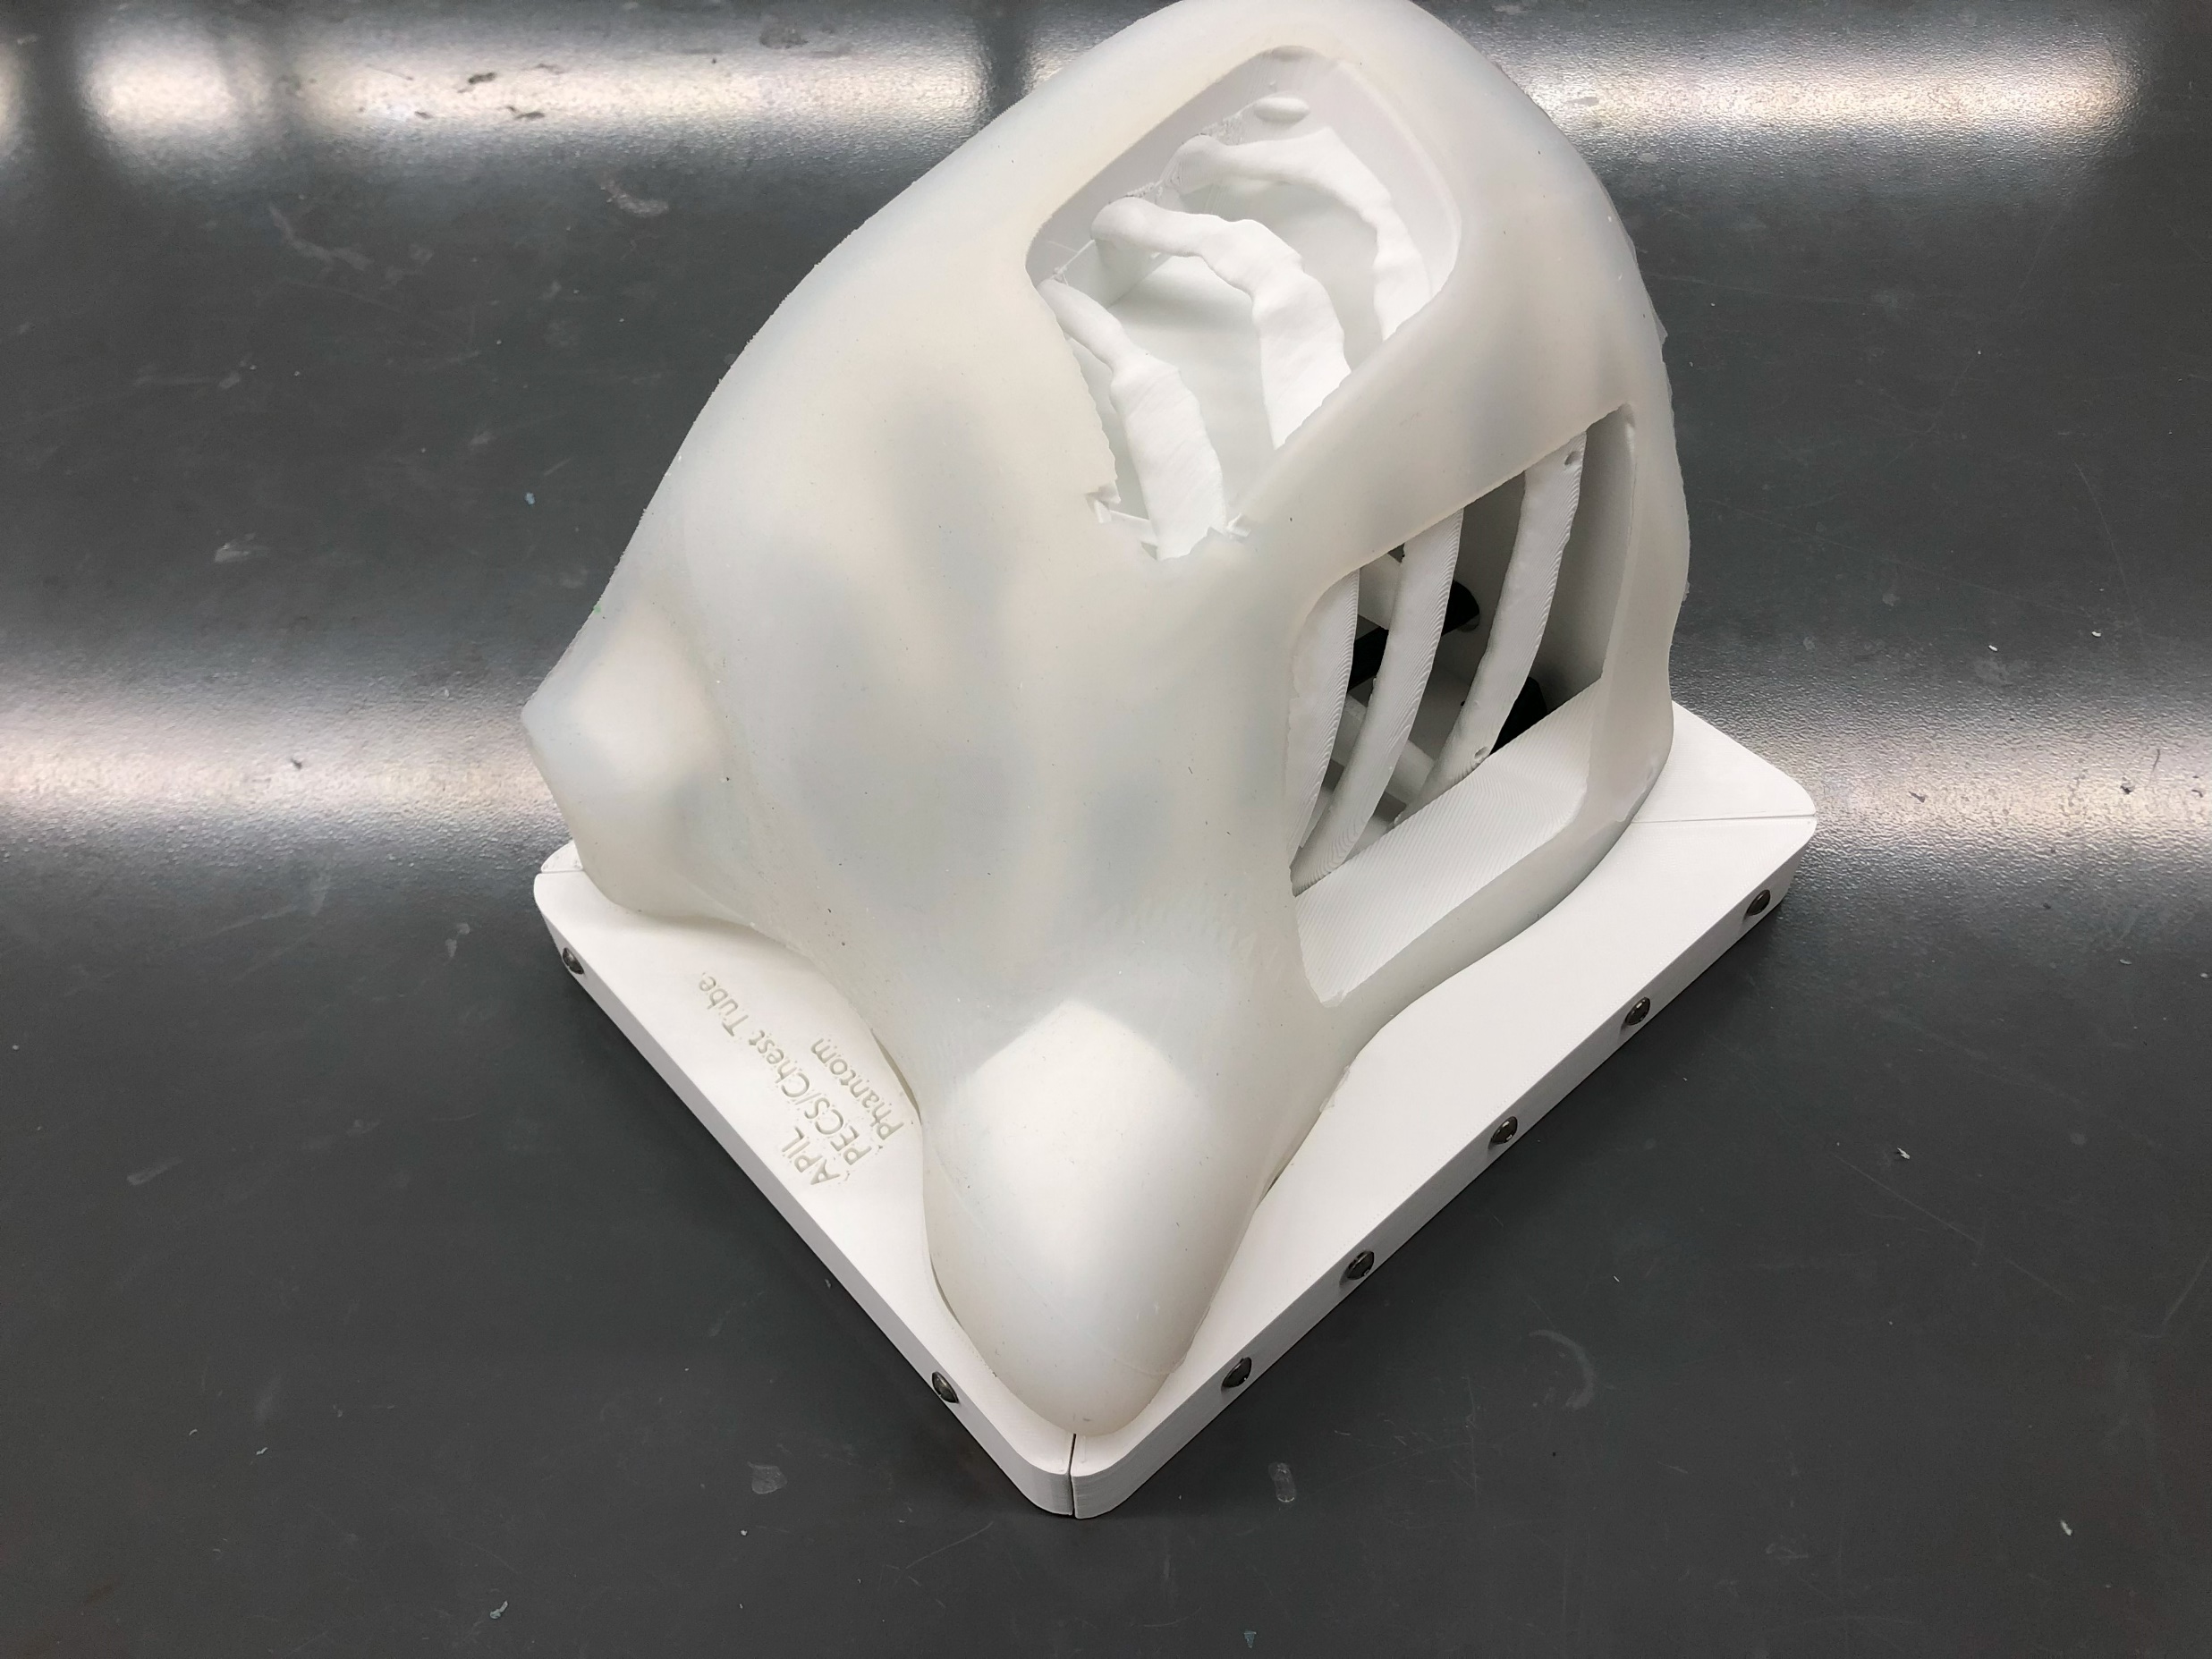

Slide 9
